Slide 1
Twitter sentiment analysis
Nguyen Kim Ngan

Slide 2
1. Data overview
​ | Count | Percentage
Positive tweets | 72249 | 44.3%​
Neutral tweets | 55211 | 33.9%
Negative tweets | 35509 | 21.8%
Total | 162969 | 100%

Slide 3
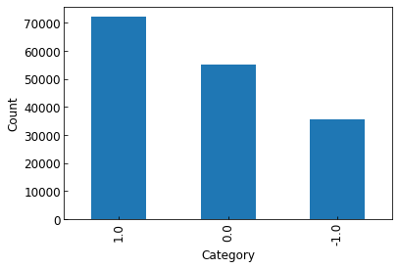
Distribution of twitter sentiment
Positive Neutral Negative
Comment: Positive tweets are the most popular.

Slide 4
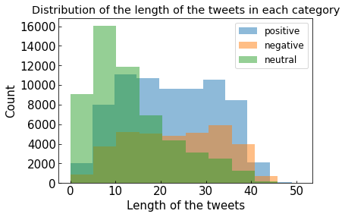
Comment: The neutral tweets are usually short while the others have medium length.

Slide 5
Most frequent words
​ | Count
Positive tweets | Modi, the, and, for, you, india, will, are, that, this
Neutral tweets | Modi, the, and, for, you, will, not, this, india
Negative tweets | Modi, the, and, for, you, not, are, that, this, will
Total | Modi, the, and, for, you, not, will, this, india, are
Comment: ”Modi” is the most frequent word in all categories. Others are mainly stopwords.

Slide 6
2. Data cleaning
Remove NaN values
Remove stopwords
Remove punctuation
Stem the words
Tokenize the words

Slide 7
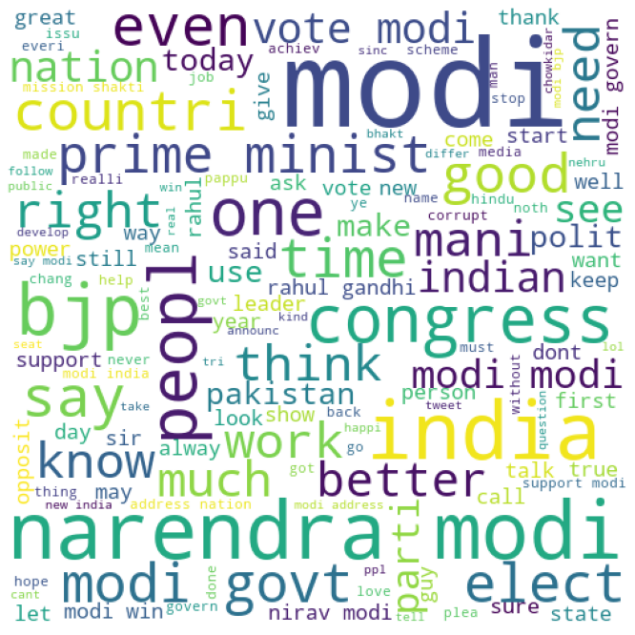
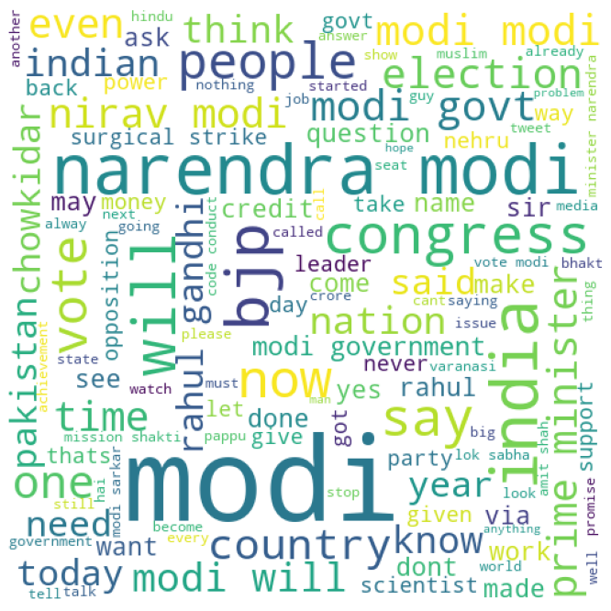
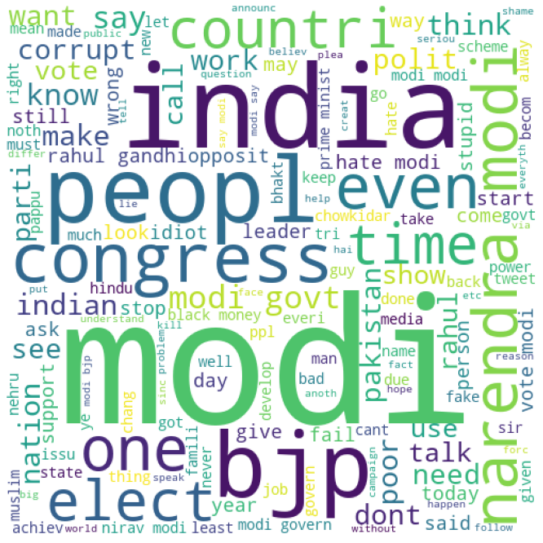
Word cloud after cleaning
Positive tweets
Neutral tweets
Negative tweets
Comment: Beside ’Modi’, the common words for positive, neutral, and negative tweets are ‘narendra’, ‘narendra’ and ‘india’, respectively.

Slide 8
3. Data model: sequential model
Sequential model: LSTM
Optimizer = adam
Loss = categorical cross entropy

Slide 9
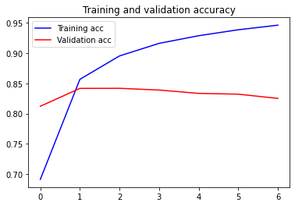
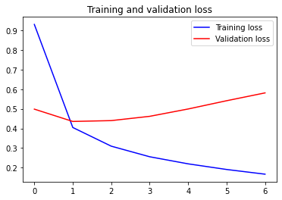
Batch_size = 512
Choose Epoch = 2 → Accuracy 85%
Accuracy
Loss
Epoch
Epoch

